Slide 1

Time is my capital, not money.
Software Engineering and Professional Practice
Group 1 – 2016/2017

Slide 2
Index
What is Metronus?
Expectations vs Reality
Financial information
Lessons learnt

Slide 3
Index
What is Metronus?
Expectations vs Reality
Financial information
Lessons learnt

Slide 4



What is Metronus?
The problem
How much time do my employees spend on each task?
Are they productive?
Are they profitable?

Slide 5

What is Metronus?
Our solution
Time control
Productivity analytics
Profit analytics

Slide 6
Index
What is Metronus?
Expectations vs Reality
Financial information
Lessons learnt

Slide 7




Expectations vs Reality
Daily work tools
Taiga.io

Slide 8




Expectations vs Reality
Technologies

Slide 9

Expectations vs Reality
Time control
Productivity Analytics
Profit Analytics

Slide 10


Expectations vs Reality
LDAP Support

Slide 11


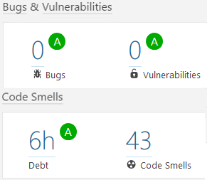



Expectations vs Reality

Slide 12
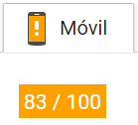
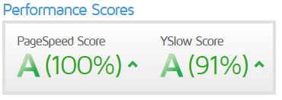
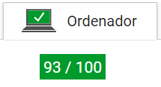
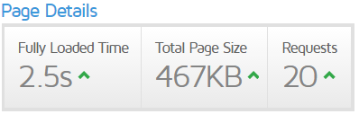
Expectations vs Reality
Google InSights
GTMetrix

Slide 13
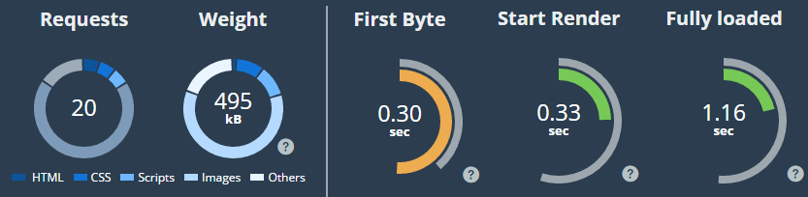
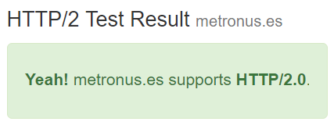
Expectations vs Reality
Dareboost
KeyCDN Test for HTTP/2.0

Slide 14
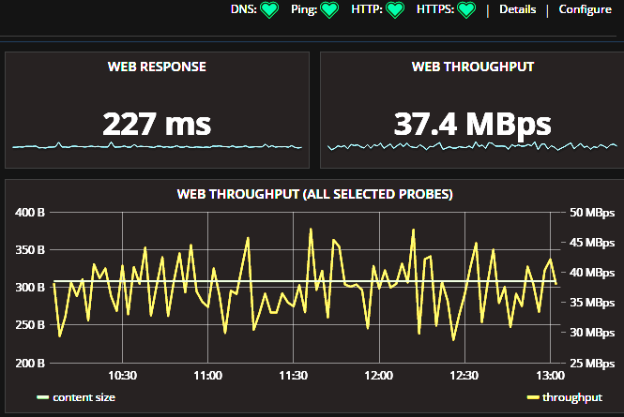
Expectations vs Reality
Grafana on stats.metronus.es

Slide 15
Expectations vs Reality
Let’s take a look at what we have developed!

Slide 16
Sprint #3 results
Oops. Something didn’t work.
Time for plan B!
https://youtu.be/FqEHkr5TkqE

Slide 17
Index
What is Metronus?
Expectations vs Reality
Financial information
Lessons learnt

Slide 18
Financial information
Budget
Paying our employees: € 22,663.85
Contingency: € 4,537.57 (20%)
Marketing: € 3,399.58 (15%)
Total: € 30,601.00

Slide 19
Financial information

Slide 20
Index
What is Metronus?
Expectations vs Reality
Financial information
Lessons learnt

Slide 21


Lessons learnt
Big team
Don’t underestimate
your PM

Slide 22


Lessons learnt
Measure
Coding standards and documentation

Slide 23
Lessons learnt
We let the team
speak individually

Slide 24
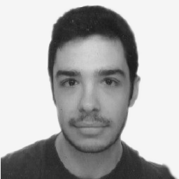
Lessons learnt
Metronus is a great idea, and the result is impressive.
Gained deeper knowledge about Django.
Agustín Borrego

Slide 25

Lessons learnt
New methodologies I didn’t use before.
Learnt to work deeply with jQuery.
Andrés Jiménez

Slide 26
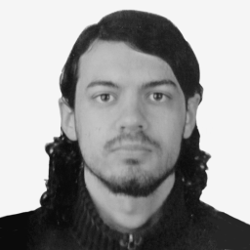
Lessons learnt
Difference between other projects within the degree and this one, much better.
José Gavilán

Slide 27
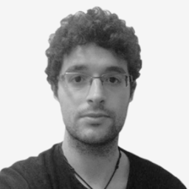
Lessons learnt
Task estimations is difficult. Think it twice before assigning a sheduled date to a task!
Jose María Jiménez

Slide 28
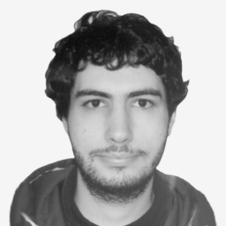
Lessons learnt
Task details should be more detailed. We can’t read minds yet!
Álvaro González

Slide 29

Lessons learnt
Metronus is useful, not just an academic project.
Learnt Django.
José Antonio Rojo

Slide 30
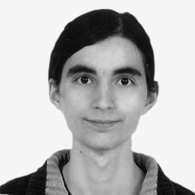
Lessons learnt
Commitment and professional work, including standards, metrics, performance, etc.
Team has worked very well under pressure and without it.
Maybe force the team to work every day, and do more scrum meetings.
Andrés Doncel

Slide 31

Lessons learnt
Technologies are just tools. They don’t determine the final result.
José Renato Ramos

Slide 32
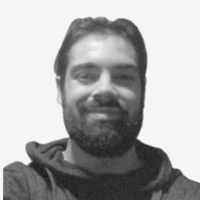
Lessons learnt
The real challenge is to achieve good results out of our comfort zone. Making it great on the Business Plan.
As little as you may give to the team, give it. The team will thank you the effort
Juan Carlos Liébana

Slide 33
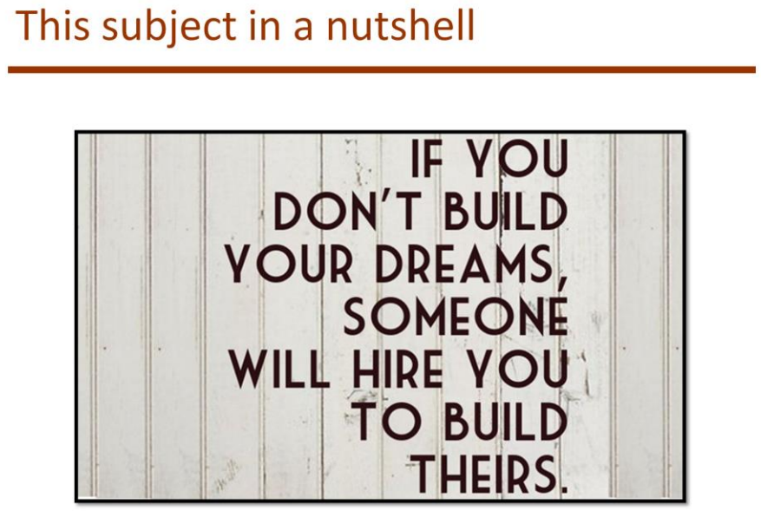
Lessons learnt

Slide 34
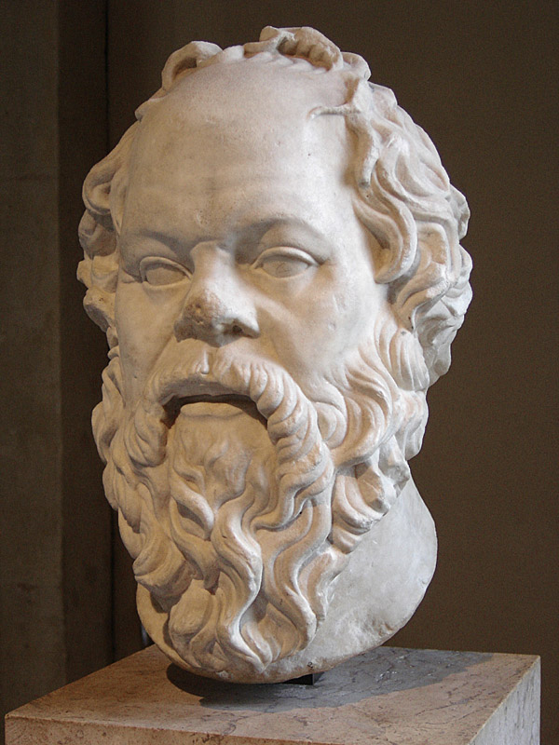
Lessons learnt
Maieutics
Methodical dialogue by which the questioned interlocutor discovers the truth by themselves.
Socrates, 470 – 399 b.C.

Slide 35
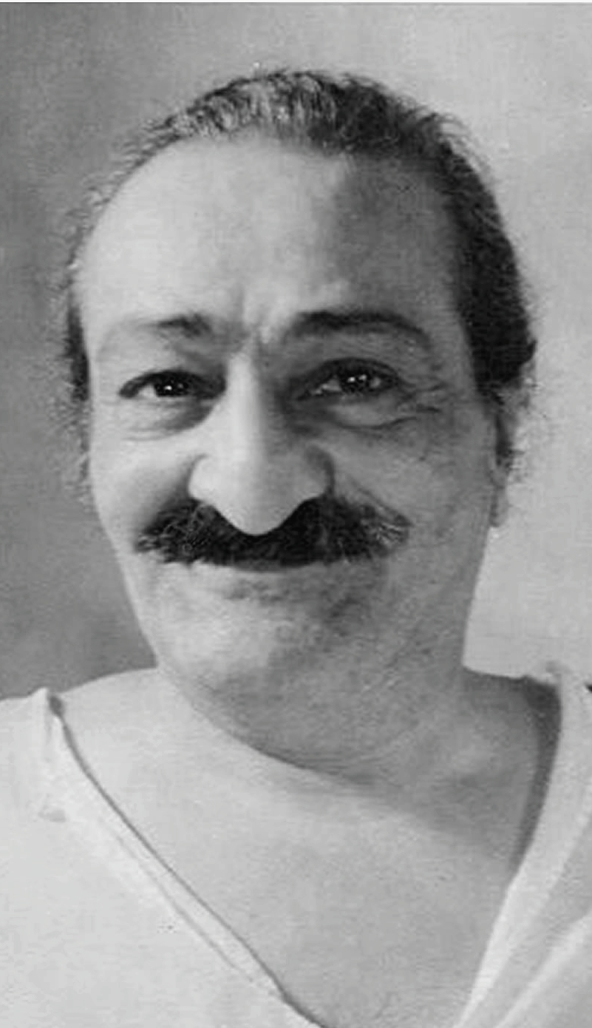
Lessons learnt
“I have come not to teach but to awaken.
Understand therefore that I lay down no precepts.”
Meher Baba, Avatar (1894 – 1969)

Slide 36



Thank you!
info@metronus.es
www.metronus.es
stats.metronus.es

